Slide 1
Global Competitiveness in a Liberalised EU Energy Market
The Role of ENTSO-E
Ifiec Energy Forum
Brussels - 22.11.11
Daniel Dobbeni

Slide 2
Topics
ENTSO-E: 18 months later
Market Integration Process
Network Code Process
Energy Infrastructure Package
Renewable integration

Slide 3
Topics
ENTSO-E: 18 months later
Market Integration Process
Network Code Process
Energy Infrastructure Package
Renewable integration

Slide 4
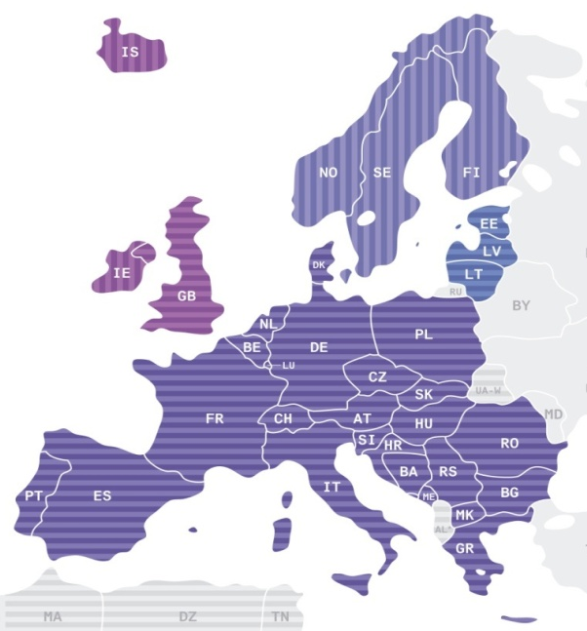
ENTSO-E: 18 months later
    Single voice for 41 TSOs from 34 countries
    From “position papers” to “formal deliverables”, a few examples
      Pilot Ten Year Development Plan
      Process for Network Code & Consultation
      Adequacy forecast & Summer/Winter Outlooks
      Work and R&D Programs
    With major challenges ahead eg.
      2nd Ten Year Network Development Plan
      Several Network Codes
      Transparency IT platform
      with a power system becoming more and more stretched

Slide 5

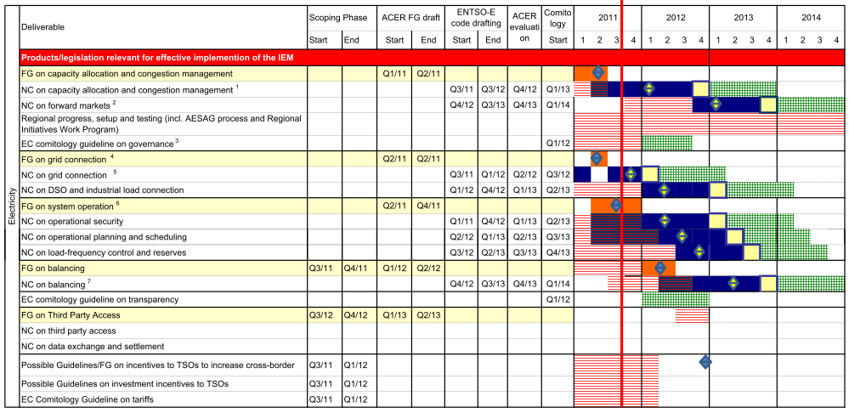


Challenging deadlines in a constant changing environment
Generator Connection
DSO & Industrial Connection
Operational Security
Operation Planning & Scheduling
Load Frequency Control & Reserves
Capacity Allocation & Congestion Mgt
Balancing
but also > 90 groups requiring ~19500 mandays/y from TSOs experts!

Slide 6
Topics
ENTSO-E: 18 months later
Market Integration Process
Network Code Process
Energy Infrastructure Package
Renewable integration

Slide 7
a Common Market Model in .. 2014 !
Coordinated ATC
NTC or Flow based
Flow based where more efficient
Balancing
DSM & DER
Day-ahead
Implicit auctions
Market coupling
Intraday
Implicit continuous trading
Monthly
Y +1
Futures Y+n
Forward Market
Physical Market
Real time

Slide 8
An example: CACM Code and Regional Projects: working in parallel
Framework Guideline
CACM
CACM Code
- Cap Calc
- Day-ahead
- Intra-Day
IEM Completion
2011
2012
2013
2014
CWE Flow Based Project
NWE Day-Ahead
NWE Intra-Day interim
FB enduring
Day-Ahead enduring
Intra-Day enduring

Slide 9
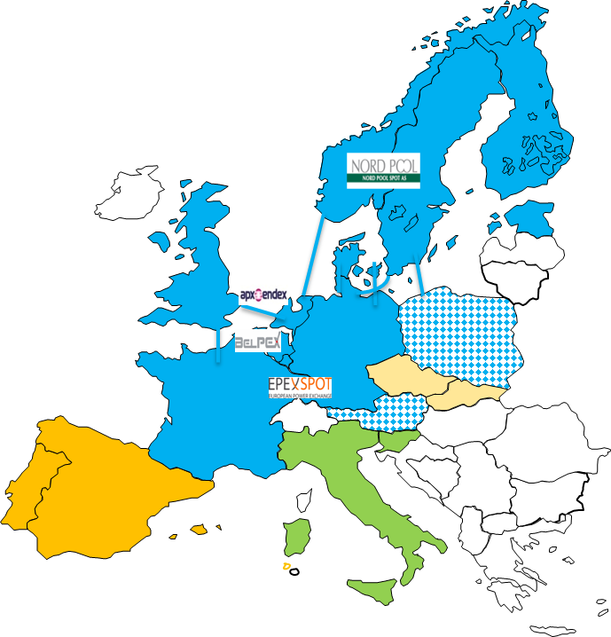
Work in progress: NWE Day Ahead price coupling
Objective
  Single algorithm
  Single price calculation
Target
    Go-live end 2012/early 2013
Status
  Governance issues
  Algorithm validation by ENTSO-E
Challenges
  Deadline
  Costs (recovery)
  Smooth extension to other MS

Slide 10
Work in progress: NWE Intra Day market
Current
Patchwork of solutions
Target March 2012
Elbas on NL-NO
Integrated market from Be to Fi
Target End 2012
“Elbas like” solution on all NWE borders
Full integrated intraday market in NWE
Note: other intemediate steps inside NWE possible as well as extension outside NWE

Slide 11
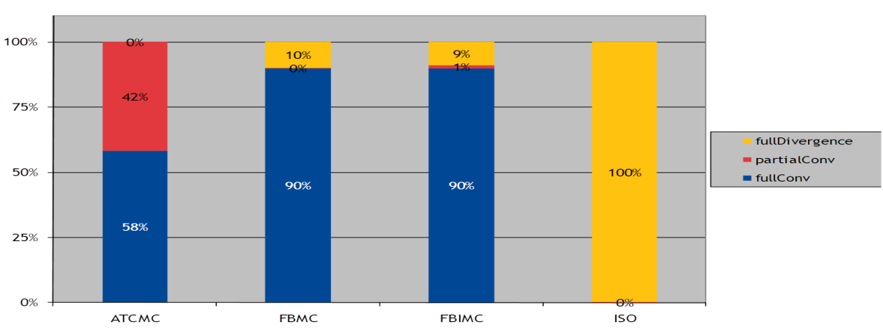
Work in progress: CWE Flow Based Capacity Calculation
Objective:
  Capacity: from “cross border” to “per branch”
Target
  go-live mid 2013
Status:
  feasibility study promising
Challenges:
  Fundamental change in capacity calculation
  Complex change management process
  Stakeholder understanding & acceptance
Next steps:
  Pursuing validation & check of assumptions
  Market participants information
  Implementation (IT, training operators)

Slide 12
Topics
ENTSO-E: 18 months later
Market Integration Process
Network Code Process
Energy Infrastructure Package
Renewable integration

Slide 13
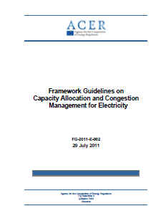
Network Codes: 2 to 3 year process
Consultation
Request to draft a FWGL
EC
Development of the FWGL (6 month period)
ACER (ERGEG)
In consultation with ENTSO-E, stakeholders + input from Expert Group
Period in which ENTSO-E can develop a NC (12 month period)
In consultation with stakeholders according to FWGL
Assessment of NC
ACER
Recommendation of NC to EC
Comitology Process (where appropriate, duration?)
EC
In consultation with all stakeholders resulting in legally binding NC
Request for ENTSO-E to draft a network code
EC
According to FWGL submitted by ACER
ENTSO-E
On a topic identified in art.8 (6) of Regulation EC 714/2009
Preliminary consultations
Code drafting
Plenary consultations: analysis, answers
Code drafting

Slide 14
The suite of network codes and framework guidelines needed for the fully integrated market before 2014
Markets
Capacity Allocation & Congestion Management
Forward Markets
System operations FG
Operational Security
Load Frequency Control & Reserves
Connection FG
Generation Connection
Demand Connection
Operational Planning & Scheduling
Balancing
CACM FG

Slide 15
Topics
ENTSO-E: 18 months later
Market Integration Process
Network Code Process
Energy Infrastructure Package
Renewable integration

Slide 16
Infrastructure regulations
Proposed Document: could lead to a major step forward
Selection of Projects of Common Interests
  TYNDP at the core of the selection of Projects of Common Interests
  Selection = Cost Benefit Analysis Method to be proposed in 2013 by ENTSO-E
  Inclusion of storage projects
Permitting
  3 years deadline with incentive to clarify national process
  but limited to Projects of Common Interests → what about the others?
EU Funding
  Only for projects not commercially viable
  with definition “not viable” to be clarified for electricity and meshed networks

Slide 17
Topics
ENTSO-E: 18 months later
Market Integration Process
Network Code Process
Energy Infrastructure Package
Renewable integration

Slide 18
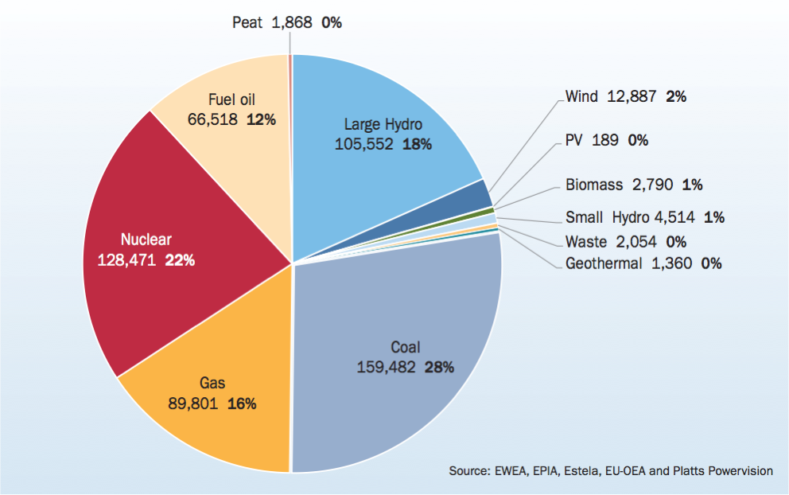
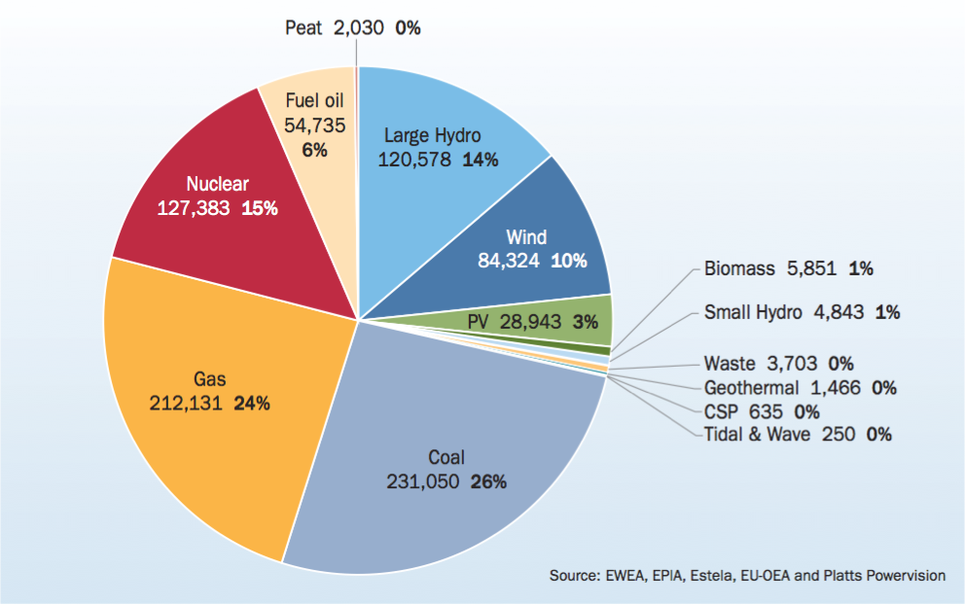
Major shift: EU Power Capacity Mix from 2000 to 2010
2010 = 887.9 GW
2000 = 575,5 GW

Slide 19
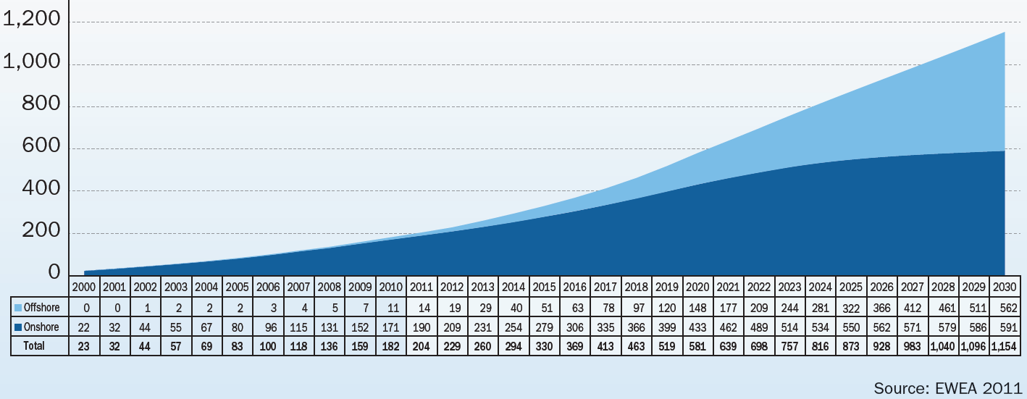
Moving higher towards 2030 and later…
Wind share of demand: 2010 = 5,3% → 2020 = 23% → 2030 = 36%
2030: 400 GW
TWh
2020: 230 GW
Offshore
150 GW
Today
40 GW
Onshore
190 GW
250 GW

Slide 20
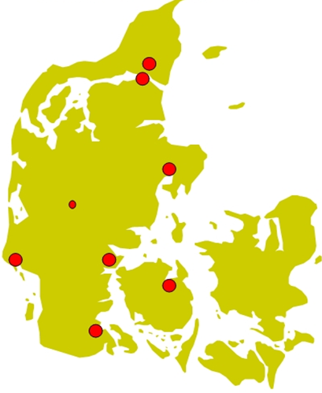
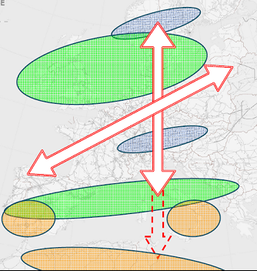
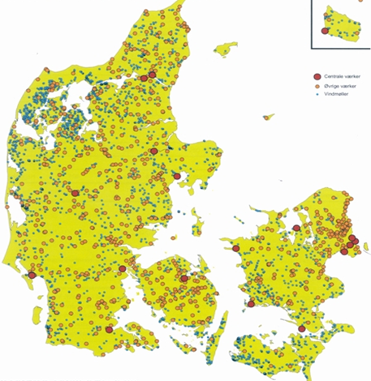
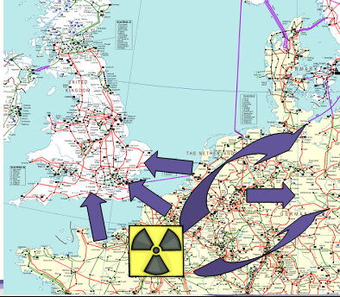
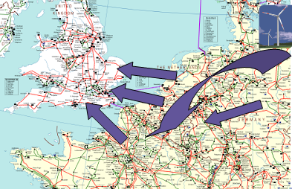
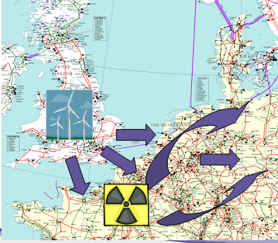
A Grid for all kind of Power flows
a. Large varying flows all over EU
From a few (very) large power plants
b. Thousands of (small) power plants
hydro
wind
solar

Slide 21
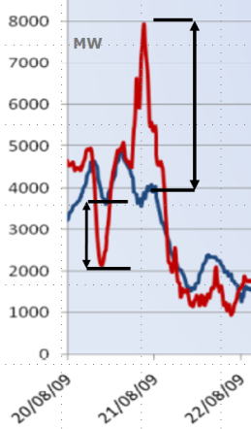
Which role for conventional power plants?
Min. demand.
(summer night)
Max. demand
(winter day)
Marginal cost
€/MWh
Peak Unit
(reserve, incidents)
Hydro Storage
f (wind, sun)
F.V.
(priority)
GW
0
1
6
10
13
15
Max. Available Power
Wind
(priority)
eg. Merit Order in 2020
Biomass units and/or
cogeneration
(priority - must run)
Nuclear
CCGT
Fossil
(coal-gas-fuel)

Slide 22
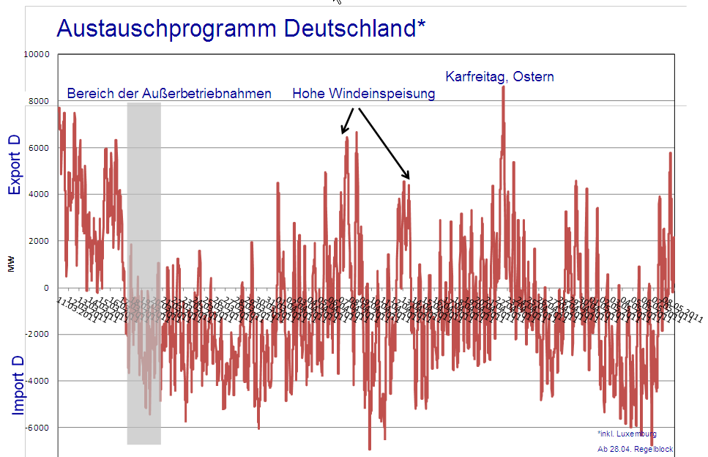
→ An important issue today?
2011
NPP Moratorium
7000 MW export to 4000 MW import in less than 24h
the interconnected systems implicitly have to deliver a flexibility equivalent to
18 CCGT plants of 400 MW reducing from 100% output to 0%
followed later on with 18+10 CCGT plants of 400 MW increasing from 0% to 100%

Slide 23
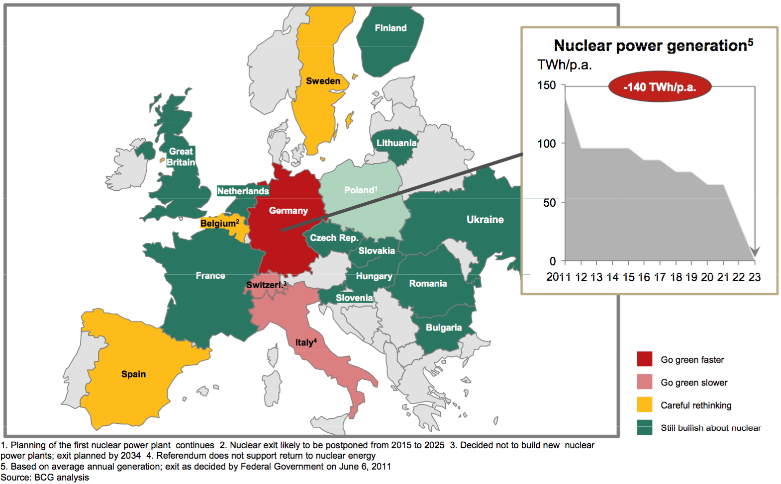
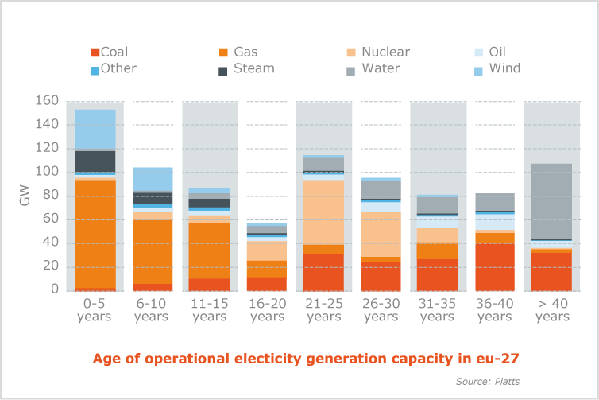
→ And tomorrow ?
From CREG study

Slide 24
Some challenges from an ENTSO-E perspective
Future Power System will become an order of magnitude more complex
  Markets and Operations more and more intertwined
  Very large geographical areas and number of market parties
NWE coupling = clear benefits with … increasing interdependence …
  Generation mix, Market mechanisms, Energy policies (including RES and DSM !)
Success factors
  Inform, explain, discuss … and start again …
  All stakeholders: same goal, same priorities, same pace … at least for reliability
  Acceptance of a loss of autonomy at Member State level
  Pragmatism !!
ENTSO-E role: reliable and open EU market … together with and for you !

Slide 25
Notes:
However the price zone issue is on the table, with all ist implications
elaborate…

