Slide 1
Energy Forum
″Global Competitiveness in a Liberalised EU Energy Market″
Study on Renewable Electricity
in EU Member States
IFIEC Working Parties Climate & Efficiency and Electricity
Dr Annette Loske
Brussels, 22 November 2011

Slide 2
Energy Balance
Energy policy for serving industry must focus equally on all three elements
Competiti
Competitiveness
veness
Security
Security
sustainability
Sustainability
Sustainability must not be developed at the expense of competitiveness
but with the target to strengthen it.
Notes:
Competitiveness is the most important elements for us.
IFIEC is afraid that sustainability has become the predominant element, and that the EU forgets about the need for competitiveness.
A balance between climate protection and international competitiveness has to be found.
Europe has done a lot over the last decades to promote climate protection and especially renewables compare to its international competitors.
EU ETS is already imposing a strict regime on the industry to protect climate, let´s not exaggerate any further neglecting the competitiveness of our European companies until a global fair playing field is realised.
Now it is a high time for our EU institutions to focus on the international competitiveness of our industries.

Slide 3
Political Context
Background: European climate targets until 2020
  Minimum 20% GHG reduction below 1990 level
  20% energy consumption from renewable sources
  20% reduction in primary energy use by improving energy efficiency
  Industry involvement
  a) Industry is already the main stakeholder impacted by the EU ETS scheme.
  b) Other sectors have to support the burden of RES.
  c) Industry‘s energy efficiency already improved a lot, there is little extra economic potential.
No over-burdening of industry until a global fair playing-field is realised.

Slide 4
Political Context
2. EU industry’s attitude:
- does not demand it
- does not reject it
- but requires to safeguard in an RES-future
competitive baseload supply
= basis for industrial activity and realistic EU future as successful and innovative economic region
Notes:
Industry has always supported EU policies and intend to do so also for RES future.
However, unless the locally imposed taxes are fully compensated, they will decrease competitiveness of European industry.
This means that the products and services needed for the 'green economy' will not be produced in Europe but will be imported.

Slide 5
Political Context
3. Renewable measures must be coordinated with energy
efficiency measures: Uncoordinated political measures
lead to suboptimal solutions.
  Energy efficiency can soften the challenge of
  20% RES and GHG reduction (less consumption → 20% rest share decreased).
  Energy efficiency is industry’s strategy for
  growth and competitiveness over last few decades.
  Energy efficiency should be the focus.
  Industries past efforts must be kept in mind while
  focussing on energy efficiency in future.
  Industry already did its share of work.

Slide 6
Financial Context
Average RES support levels in € / MWh
Source: CEER Report on Renewable Energy Support in Europe.
Notes:
Res support is non-harmonized in EU.
→ Wide range of support schemes with wide range of resulting financial characteristics – more than 300 % differences.
→ RES is not competitive and require important support.

Slide 7
Financial Context
Surcharge on electricity price due to support schemes for renewable electricity in € / MWh
Worst case scenario: burden for consumers without compensation → unbearable for industry
€/MWh
Notes:
Graph illustrates the surcharge on electricity price due to the support of renewable electricity. Special regimes for industrial electricity consumers are not considered.
The illustration underlines the following conclusions:
Costs to electricity consumers differ greatly between countries.
Costs to electricity consumers have increased and are expected to increase further drastically in all countries.

Slide 8
Financial Context
% of electricity in renewable production: Development until 2008 vs. targets until 2020
Red column targets mean: much more action is needed very quickly.
→ Trend: Even higher support needed!
%
Source: EUROSTAT, NREAP
Notes:
Graph shows the share of electricity from renewable energies in several EU Member States.
The figures until 2008 show the actual development based on the latest Eurostat data (columns in blue).
The columns in red depict the planned development until 2020 according to the NREAP.
The picture clearly shows the different pace of the actual development until 2008 and the planned development until 2020.
While the actual development until 2008 has been a moderate increase in most countries, the growth rate of renewable electricity is planned to increase massively until 2020.

Slide 9
Financial Context
% of renewable electricity in total electricity consumption:
2010 target (2001/77) vs. expectation (acc. to NREAP)
Already 2010: Expectations not met despite high support!
Source: EUROSTAT/energy/data
NREAP: National Renewable Energy Action Plan
Notes:
According to the latest EU progress report, the EU is unlikely to meet its renewable electricity target of 21 % by 2010 (set by Directive 2001/77). As can be seen in the graph, only three of the 12 EU member states picked out expect to meet their target for 2010.
The EU even expects that in fact only four of the 27 member states will actually meet their 2010 targets.

Slide 10
International Context
Wind power development not balanced globally
Notes:
This effort is much smaller in other parts of the world.

Slide 11
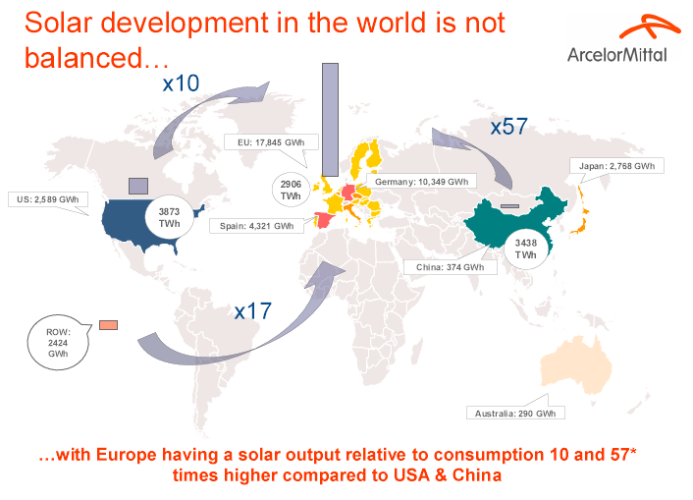
International Context
Solar development in the world is not balanced with Europe having a solar output relative to consumption 10 and 57* times higher compared to USA & China.
Need to protect our industries until similar levels are achieved internationally
and costs are shared evenly.

Slide 12
EU Support Scheme: IFIEC View
Why is a support scheme necessary?
  RES is not competitive with conventional generation.
  Therefore support unavoidable, but must be
  proportionate (budgeted).
  Bridge the gap between RES and non-RES.
Why in favour of one EU-wide system?
  To avoid competitiveness distortions for industry within
  Europe.
  To optimize geographical benefits in order to achieve
  most cost-efficient mix.
  To achieve EU target while safeguarding global
  competitiveness.
  To be as much as possible compatible with the target of
  an internal market.

Slide 13
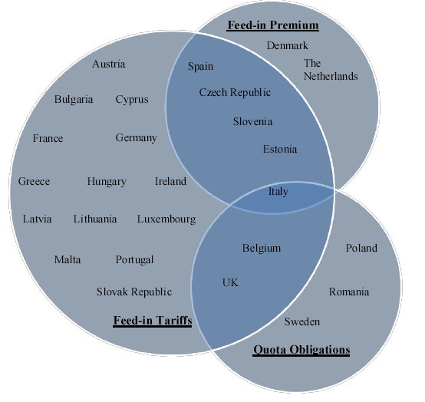
EU MS‘s Support Schemes
Diversity of approaches as an obstacle to come to the most efficient solutions
Source: CEER; Ref. C11-SDE-25-04. Adapted from EU COM Report „Renewable Energy“, Jan. 2011.
Notes:
Certificate is a tradable commodity proving that certain electricity is generated using renewable energy sources.
Available instruments?
Feed-in tariffs or feed-in premium
Quota obligations based on tradable green certificates
Investment grants
Tender procedurces
Tax measures

Slide 14
EU Support Scheme: IFIEC Principles
Several principles should apply to this support system:
Technology-specific support
  To reflect the highly differing costs of the different types of RES technologies
  Rejection of a one price-system for all technologies (prevent windfall profits)
Based upon electricity market price
  Difference between technology-specific guaranteed tariff and average electricity price paid directly to producer of green electricity
Decreasing support for new projects over time
  Support only for non-depreciated installations
  To reflect technological progress
  To avoid over/compensation
Extra incentives for superior CO2 abatement technologies
  For more mature technologies based on CO2 saving/euro support
  For competition between technologies in order to achieve competitiveness
  To realize least abatement costs
Specific grid connection cost financed through support scheme
Guarantee of origin system used for tracking and trading

Slide 15
IFIEC Conclusions
Overall climate policy should be optimised in cost efficiency
  E.g. optimization between renewables & energy efficiency measures
Budgeted support
R&D first: Immature technologies should be supported by R&D and reach an acceptable level of cost before massive roll-out and exploitation support
Support scheme financing also through state budget in order to attain more consciousness on cost impact of support policies
Transparency of any direct and indirect costs
Cost for grid extensions and balancing must be borne by producers

Slide 16
IFIEC Position
IFIEC accepts and contributes significantly to the political 20-20-20 decision but emphasizes the need for a smart roll-out that safeguards international competition of energy intensive industry.
IFIEC does not oppose RES development policy because it’s supposed to lead to improved competitiveness in the long run.
But RES does not correspond to our needs(secure and competitive power supply) and their development cost are far too high to be shared by industry. Overall costs need to be lowered via a harmonized and cost-efficient EU wide support system under a strict budget policy including special treatment for industrial consumers.

