Slide 1
IFIEC Energy Forum
How to adjust the EU Climate and Energy Policies in light of the financial crisis? – An enhanced EU ETS
19 June 2012
Annette Loske
Chairwoman WP Climate and Efficiency
Managing Director German Federation of Industrial Energy Consumers (VIK)

Slide 2
ETS balance
ETS – a system under criticism
ETS – a system that we still favor
It works! – will deliver the fixed emissions cap in the EU
Overhanging allowances – two sides of one coin:
  Bad news
  – a system design with several flaws in it
  – it needs a reform (quite simple changes to adjust)
  Good news
    – Lower emissions than planned
    – functioning carbon reduction at low costs

Slide 3

Industry in need for a global approach
ETS is a door-opener to a global climate change policy approach
Could safeguard level playing field
A precondition for EU industry‘s competitiveness and ability to strengthen EU economy in order to overcome current crisis
Objective: Make ETS an attractive climate change policy approach for other countries/regions

Slide 4
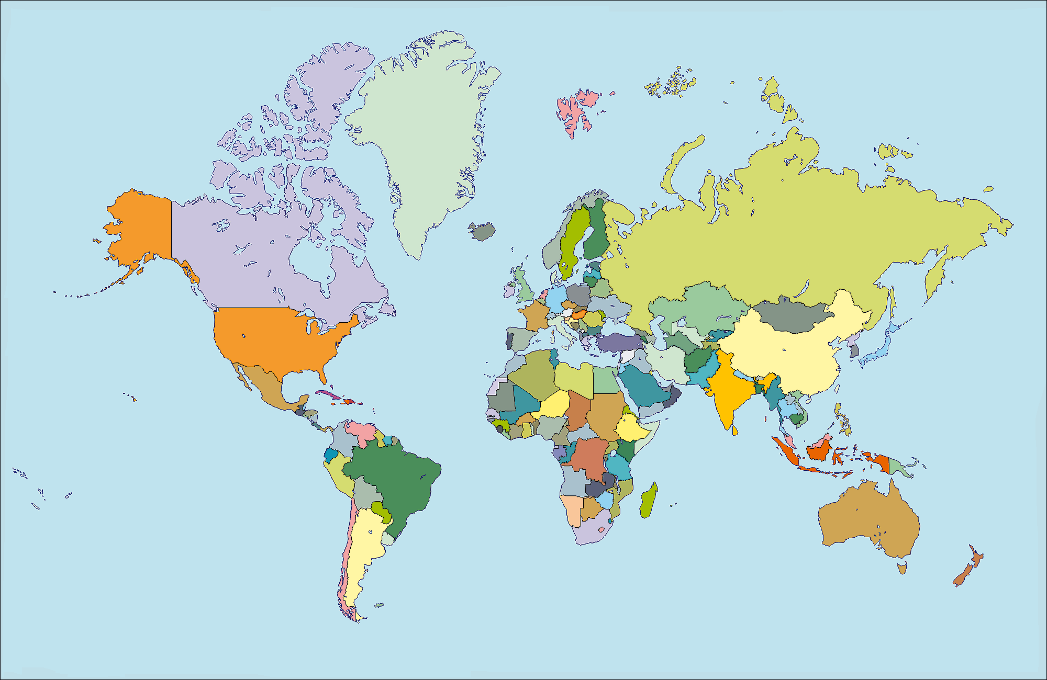
Countries others than EU with ETS approach (planned or installed)
South Korea
China
California
India
Australia

Slide 5
How to become a blueprint
  Make it more stable, robust, predictable and capable to help strengthening EU economy
  Make it compatible with industrial growth
  Do not interfere, which would signal: it does not work
  No arbitrary, improvised set aside or price setting, but logical changes that makes ETS attractive even for fast developing countries with a massive carbon output (the ones that really count!)

Slide 6
Countries that must be part of a balanced global climate change approach
Canada
Russia
USA
South Korea
China
India
Brazil

Slide 7
6 steps to a blueprint
The following changes are needed:
Allocation must reflect actual rather than historic production level, in order to
avoid both under- and over-allocation
make it recession-proof
avoid highly complex and error-prone set of rules to cope with dynamics between history and reality
Mitigate limitations for growth

Slide 8
6 steps to a blueprint
Benchmarks to be challenging, but giving necessary time to adapt
High efficiency level not at the starting point but at the end
New entrants reserve must be replenished
If depleted, also after 2020
Emitters must have certainty for future investments

Slide 9
6 steps to a blueprint
Unstable financial compensation model for indirect emissions to be changed into a long-term predictable system
Indirect allocation as the better option
Review of the carbon leakage list not to jeopardise the carbon leakage status of energy intensive sectors currently on the list.
Until global auctioning system established
Give industry regulatory certainty for long-term planning
Avoid basing policy on unreliable statistical data
Auctioning is fine, but only if and when globally emitters must have certainty for future investments

Slide 10
6 steps to a blueprint
Linear factor for new entrants and heat users from cogeneration plants being electricity generators to be abandoned
For the sake of equal treatment for all industry incumbents and new entrants

Slide 11
Conclusions
Vitally important to have global ETS by around 2020.
In absence of realistic perspective for effective global agreement by 2020, the principle of the EU cap must be revisited before 2020.
Let‘s build an ETS that is more robust, predictable, effective and recession-proof = the driver for carbon reductions in a world of economic growth and innovation!

