Slide 1
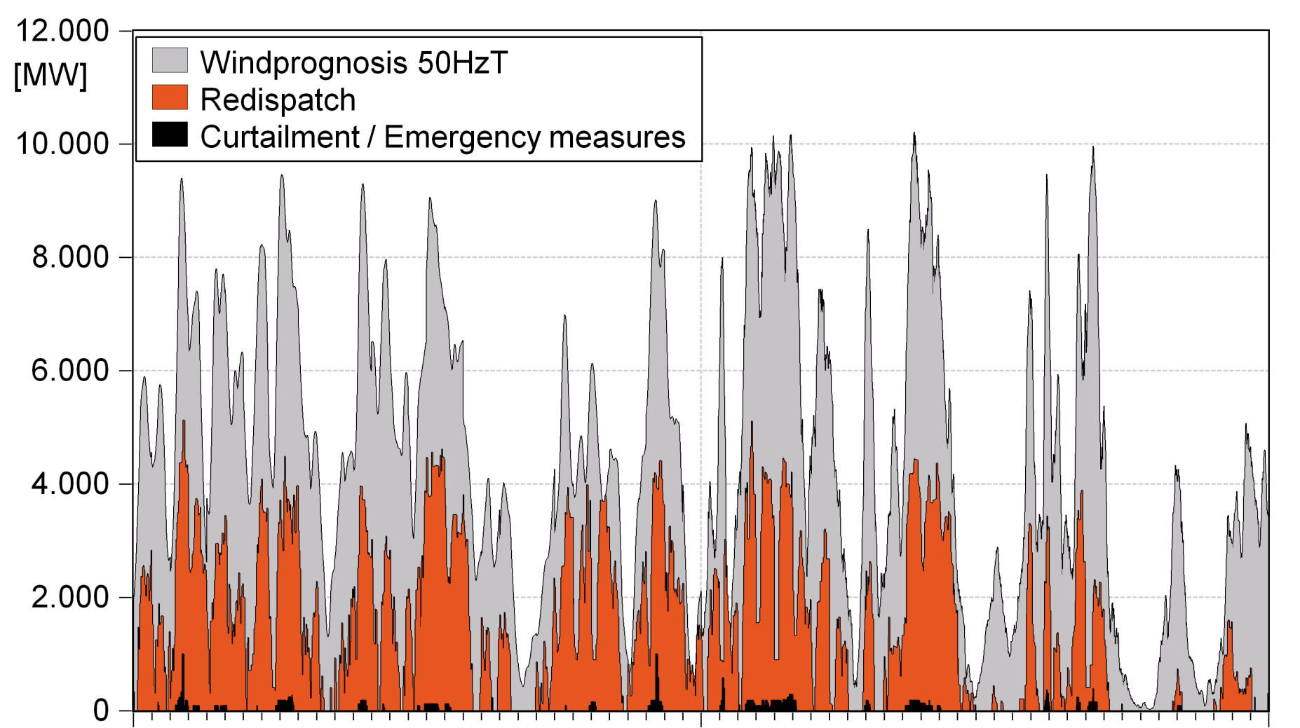
RES = transmission capacity or ...
MW
December 2011
January 2012

Slide 2
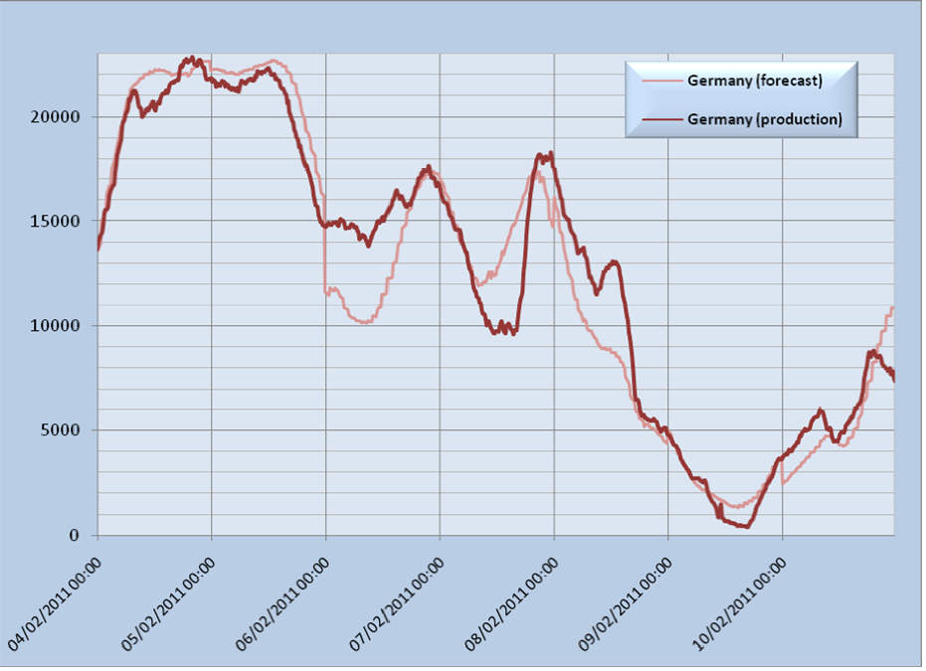
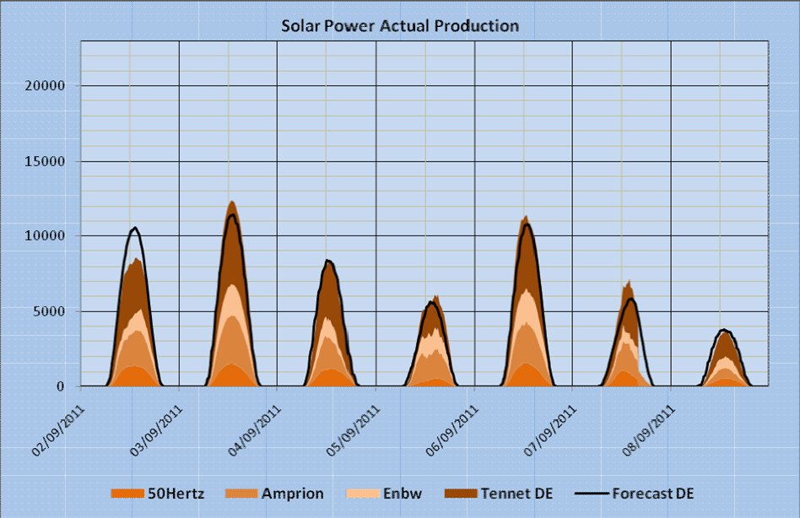
RES = flexibility or ...
2011
~50 % generation = Wind + PV
Flexible CCGT =2000-3000 h /yr
Reserves R1-R2-R3 due to forecast error= ~ 5 GW
Assuming 400 MW CCGT units with fast ramping of ~150 MW
~33 CCGT units
Forecast – actual: 5 GW
Max – min generation : 23 GW
2012 peak = 22GW
Forecast – actual : 2 GW
Delta peak in 1 week: 9 GW

Slide 3
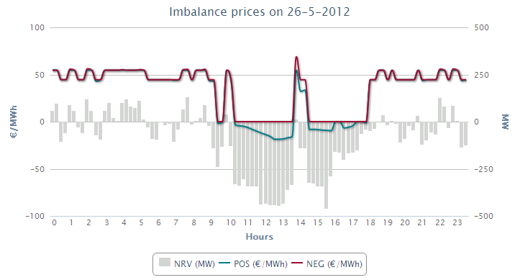
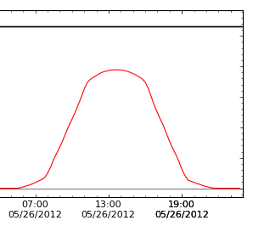
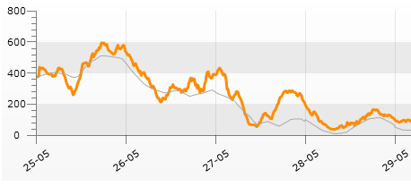
RES = transmission & flexibility & market or ...
-18.5 EUR/MWh for
positive imbalance
BE Sun forecast
wind forecast & reality
NRV is the difference (for each moment) between the sum of volumes of all upward regulations and the
sum of volumes of all downward regulations requested by Elia to maintain the balance of the control area

Slide 4
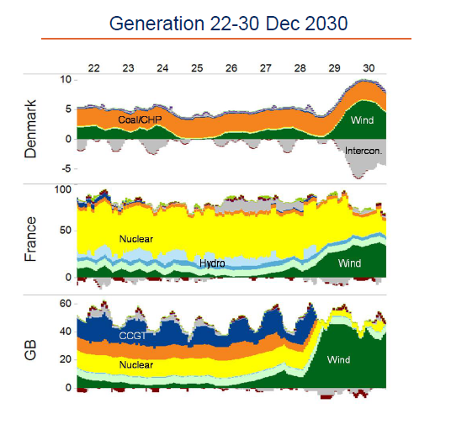
Belgium: Wind + PV = 8 GW in 2020 GB – FR – DK : generation-mix 2030
Source:: Pöyry

Slide 5
RES = transmission/distribution & flexibility & market
EU cross-border intraday market & EU-wide control area balancing.
Synchronise RES with development of transmission/distribution capacity
Active management of RES by DSO/TSOs especially for “low load”
Incentives for flexible generation to overcome merely 2000 – 3000 h utilisation (e.g. gas CCGT, biomass)
High power interconnectors with flexible Nordic/Austrian/Swiss systems
TSOs investment in specific ancillary services (operational reserves) without participating in commodity market
Increased R&D in storage systems.

